Slide 1
Sales Prediction
Project Overview
By: Owuza Olowu & Saheed Adeitan

Slide 2
Table of Contents
Objective
Introduction
Exploratory Data Analysis (EDA)
Data preprocessing
Prediction model

Slide 3
Objective
To analyze the sales trend over a period of time.
Deciding on predictive model used and rationale behind it.
Prediction of 6 - 12 months range.

Slide 4
Introduction to Sales Dataset
Overview
Revenue
Time frame
Variables
Data source: https://www.kaggle.com/datasets/rohitsahoo/sales-forecasting

Slide 5
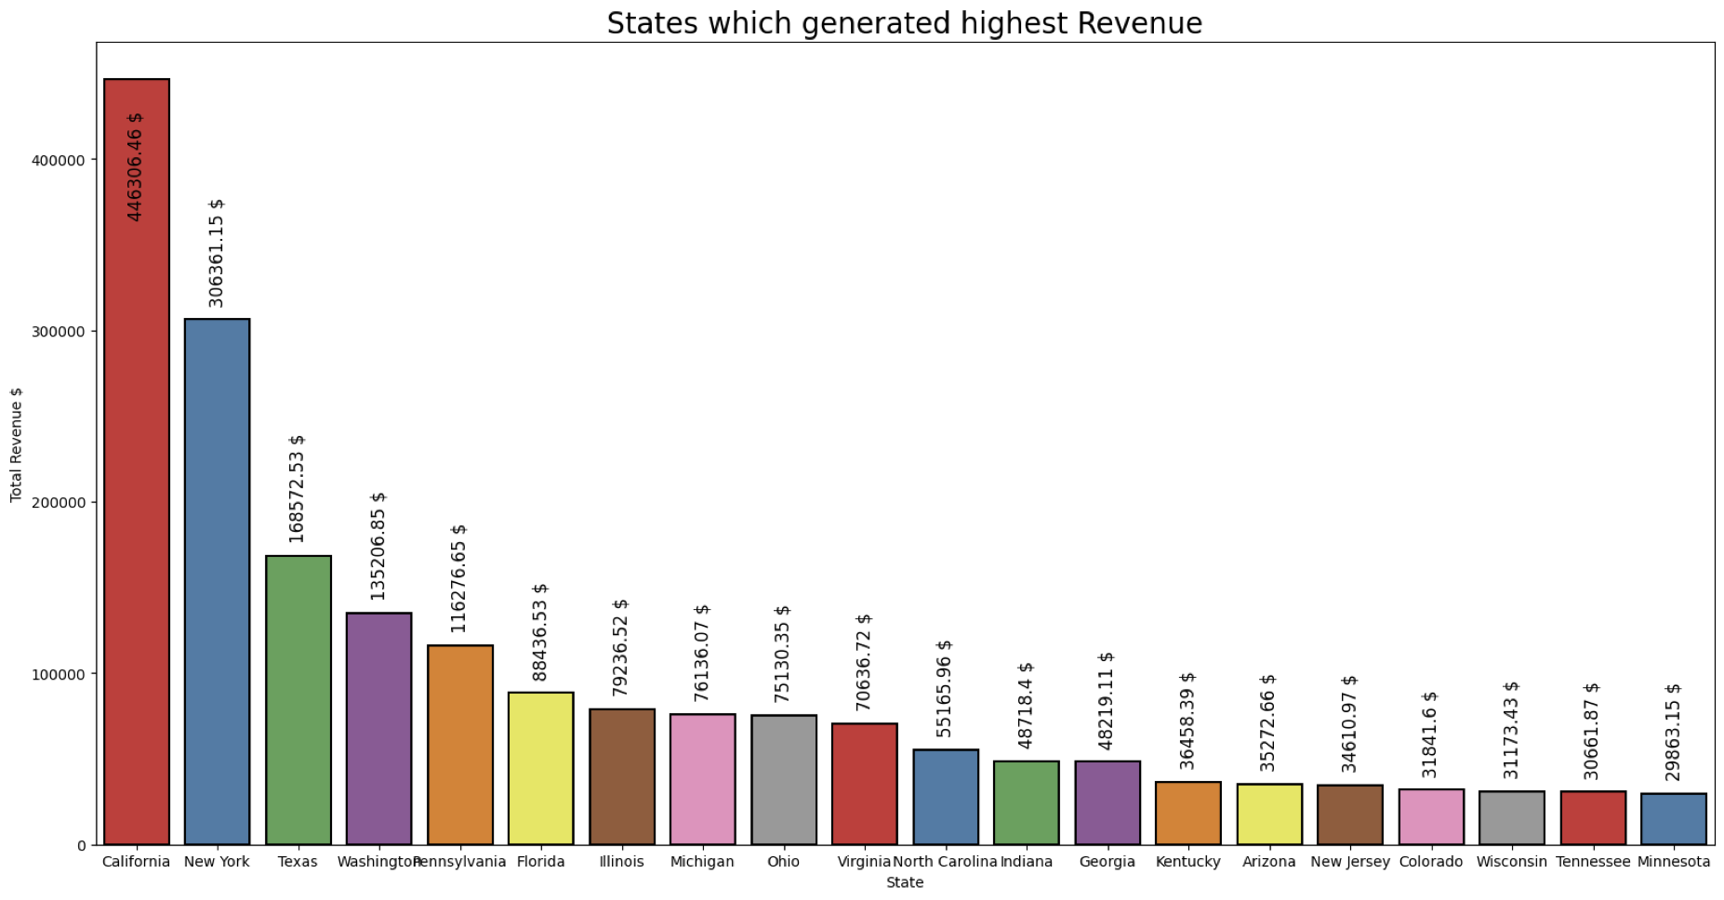
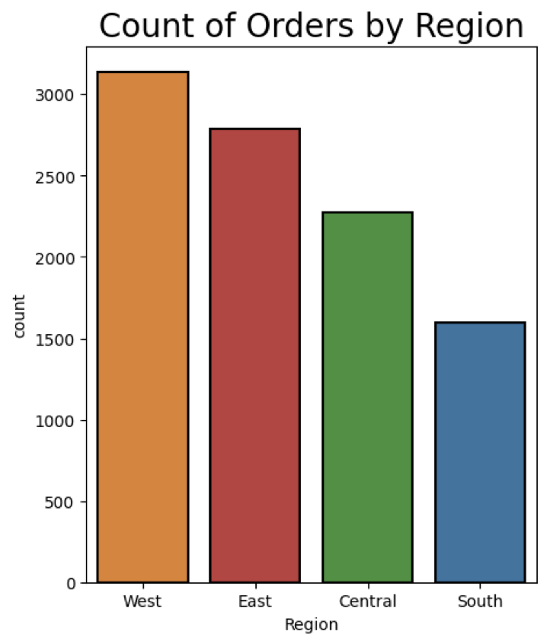
Exploratory Data Analysis

Slide 6
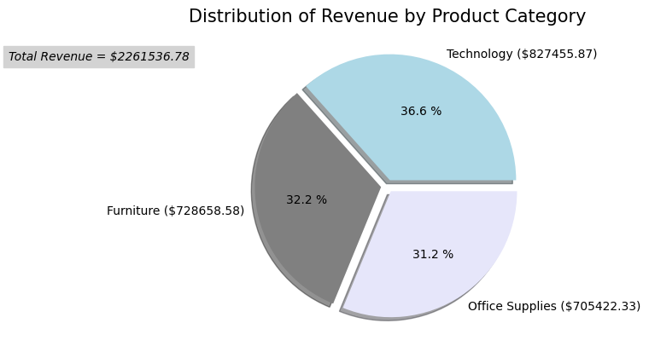
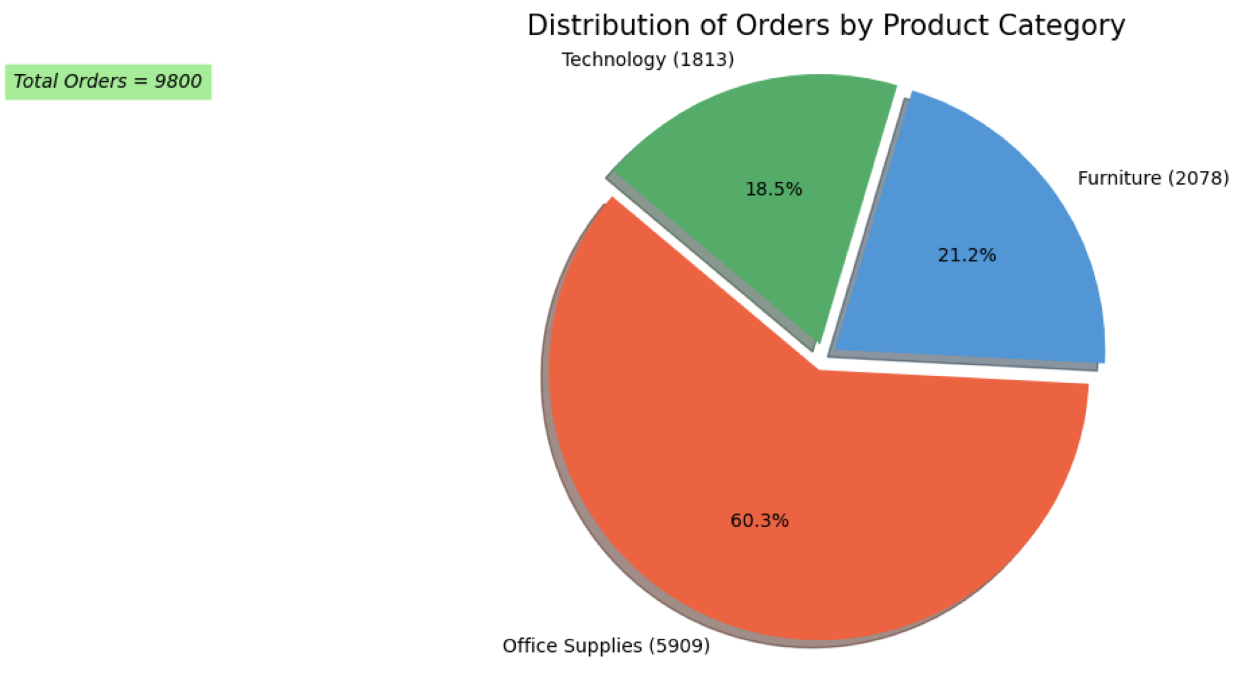

Slide 7
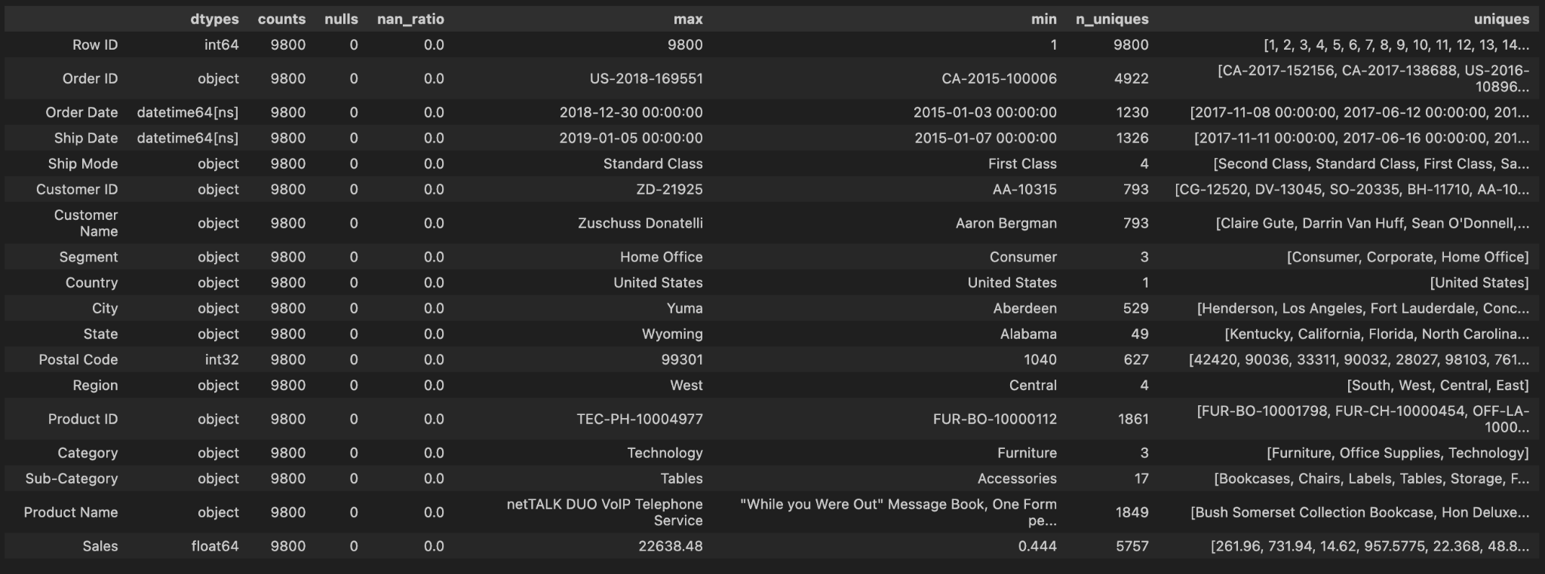
Data pre-processing
Checking for missing value- Postal code column
Replacing missing value
Confirming if data is ready for modeling
Changing Order_Date and Ship_Date Format to date time
Sorting (rearranging data with date)

Slide 8
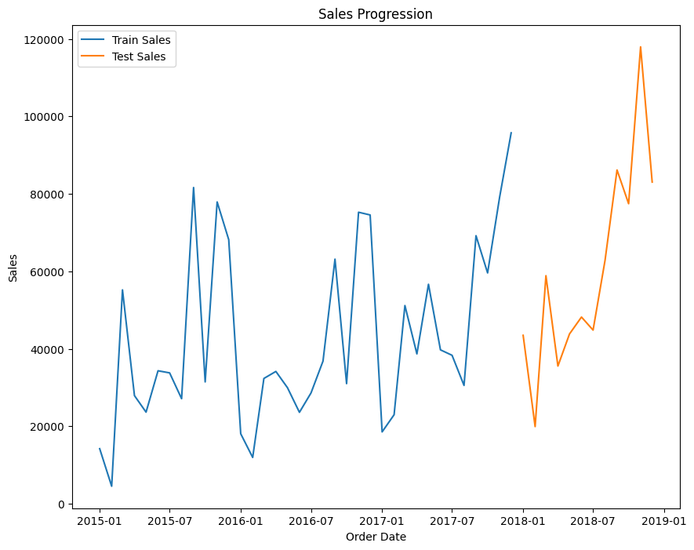
Prediction Model

Slide 9
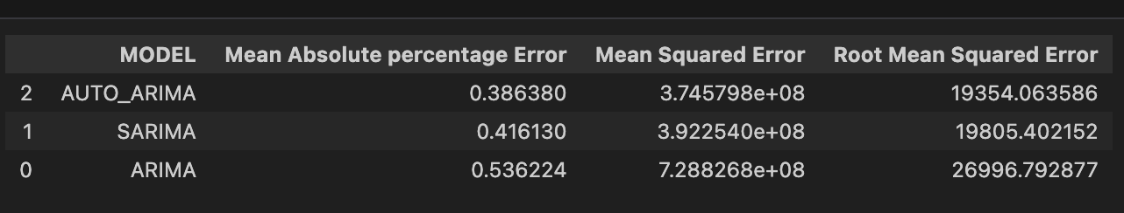
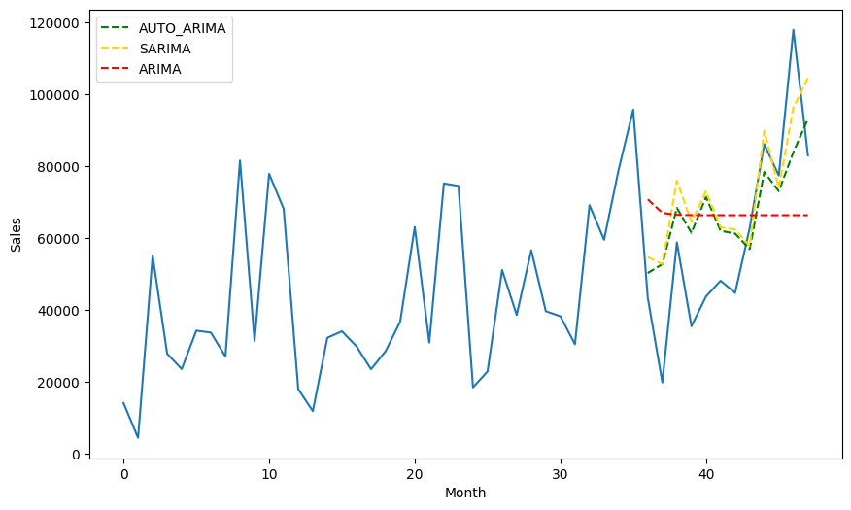
Model report

Slide 10
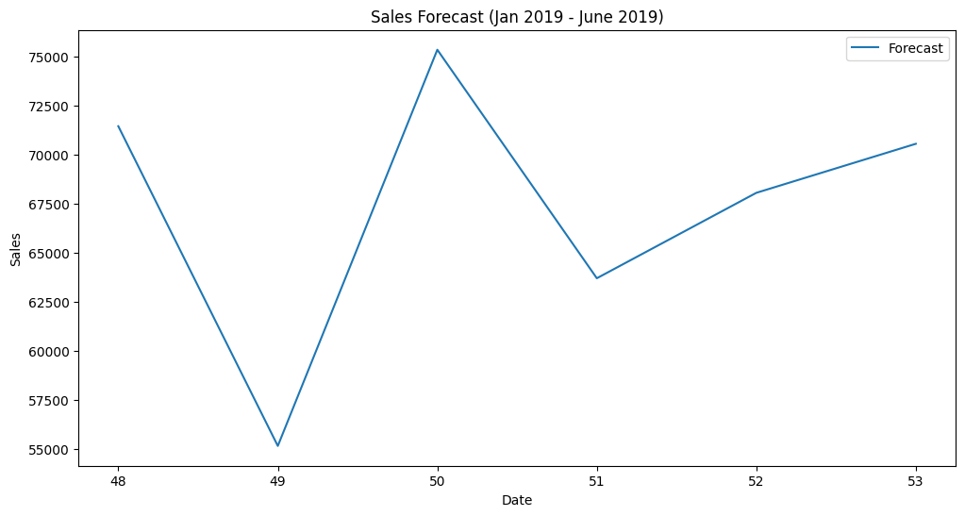
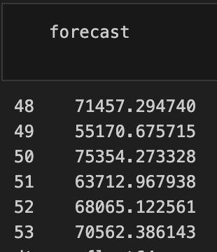
Auto-arima Model
Click here to test: Streamlit (siglbhddlm5ce9k5zsdge7.streamlit.app)
SALES FORECAST VALUES

